Slide 1


Slide 2
4.1 Boolean Operations and Expressions
Variable: a symbol used to represent a logical quantity;
Complement: the inverse of a variable
  Be indicated by a bar over the variable: NOT operation
Boolean Addition: OR operation
Boolean Multiplication: equivalent to the AND operation.

Slide 3
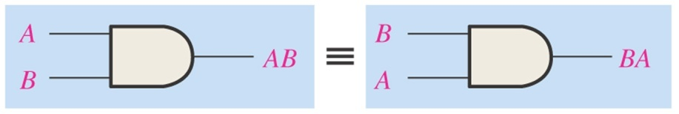
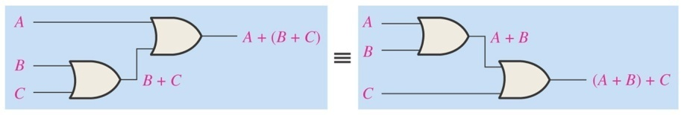
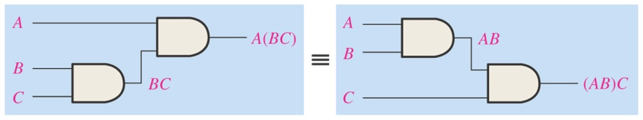
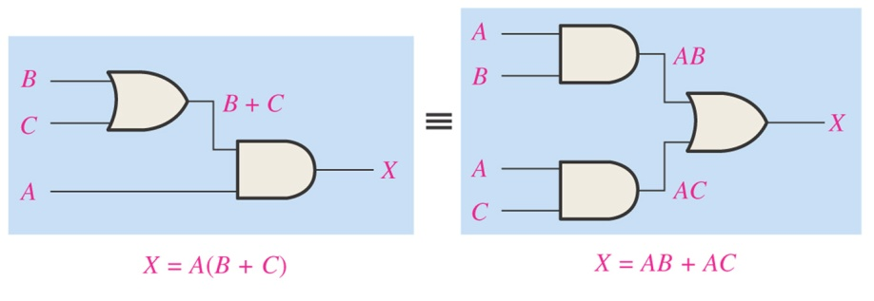
4.2 Laws and Rules of Boolean Algebra
Laws of Boolean Algebra
  Commutative Laws
    A+B=B+A
    AB=BA
  Associative Laws
    A+(B+C)=(A+B)+C
    A(BC)=(AB)C
  Distributive Law
    A(B+C)=AB+AC

Slide 4
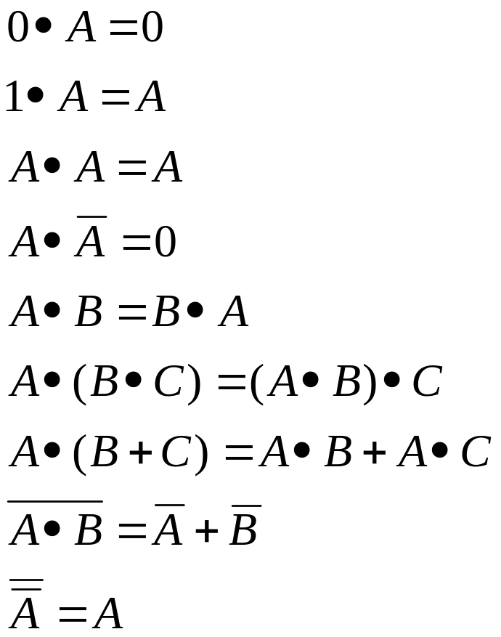
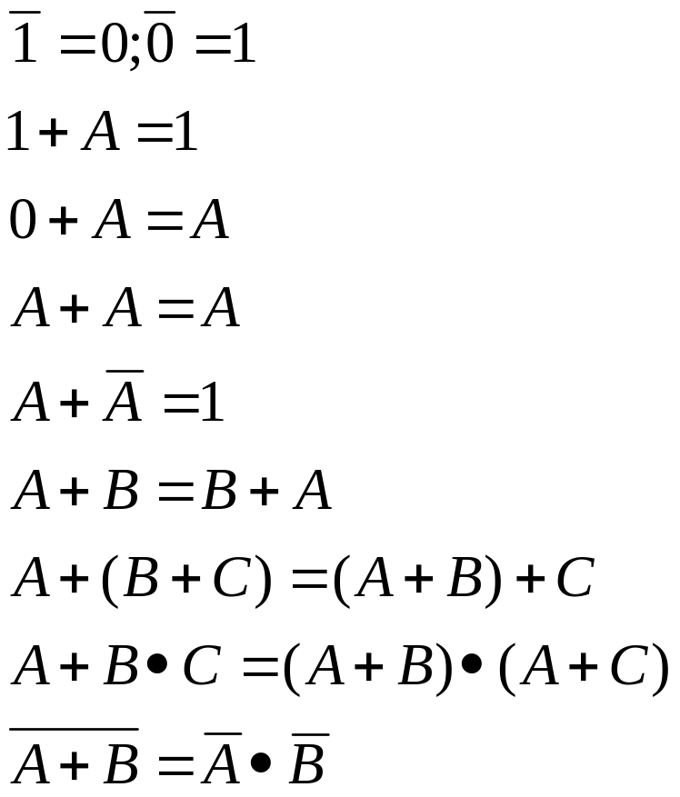
Rules of Boolean Algebra

Slide 5
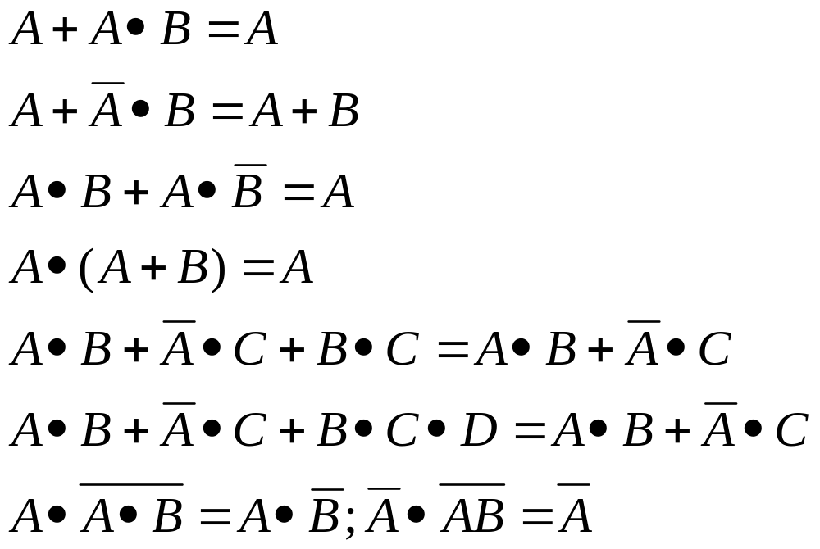

Slide 6
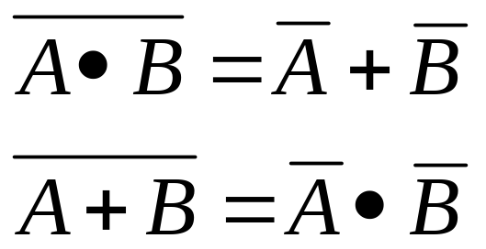
4.3 Demorgan’s Theorems
The complement of a product of variables is equal to the sum of the complements of the variables
The complement of a sum of variables is equal to the product of the complements of the variables

Slide 7
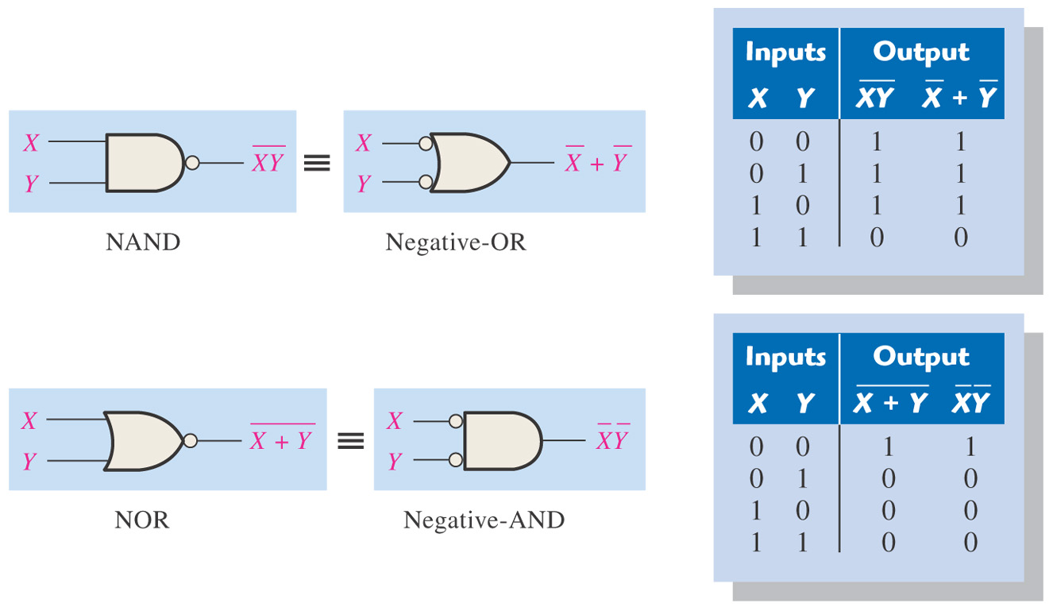
Figure 4–15 Gate equivalencies and the corresponding truth tables that illustrate DeMorgan’s theorems. Notice the equality of the two output columns in each table. This shows that the equivalent gates perform the same logic function.

Slide 8
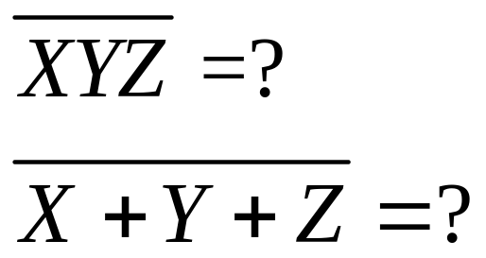
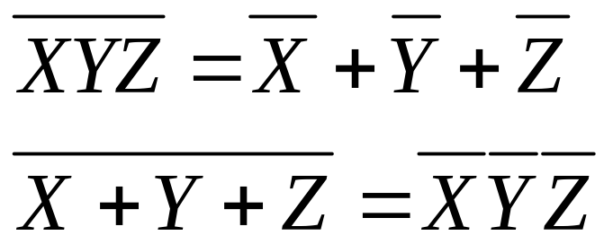
Example: Apply DeMorgan’s theorems to the following expressions

Slide 9
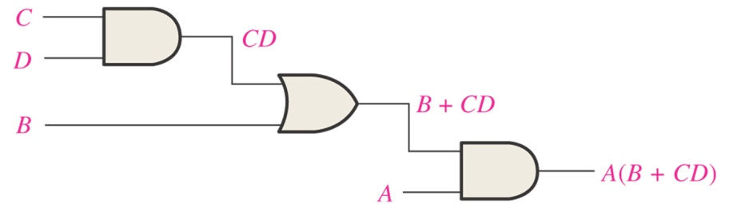
4.4 Boolean Analysis of Logic Circuits
Boolean Expression for a Logic Circuit
Constructing a Truth Table for a Logic Circuit
A | B | C | D | A(B+CD)
0 | 0 | 0 | 0 | 0
0 | 0 | 0 | 1 | 0
0 | 0 | 1 | 0 | 0
0 | 0 | 1 | 1 | 0
0 | 1 | 0 | 0 | 0
0 | 1 | 0 | 1 | 0
0 | 1 | 1 | 0 | 0
0 | 1 | 1 | 1 | 0
1 | 0 | 0 | 0 | 0
1 | 0 | 0 | 1 | 0
1 | 0 | 1 | 0 | 0
1 | 0 | 1 | 1 | 1
1 | 1 | 0 | 0 | 1
1 | 1 | 0 | 1 | 1
1 | 1 | 1 | 0 | 1
1 | 1 | 1 | 1 | 1

Slide 10
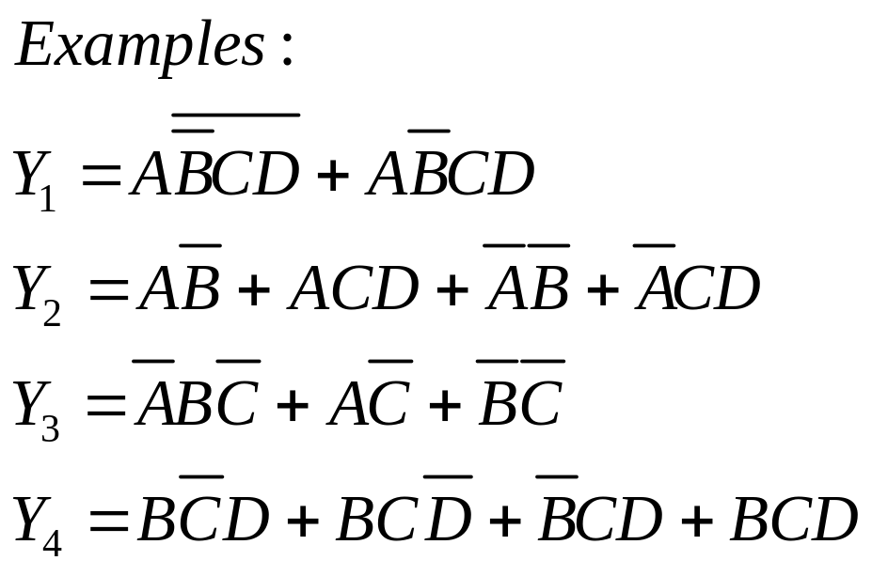
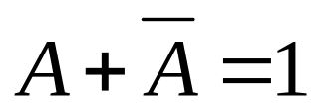
4.5 Simplification Using Boolean Algebra

Slide 11
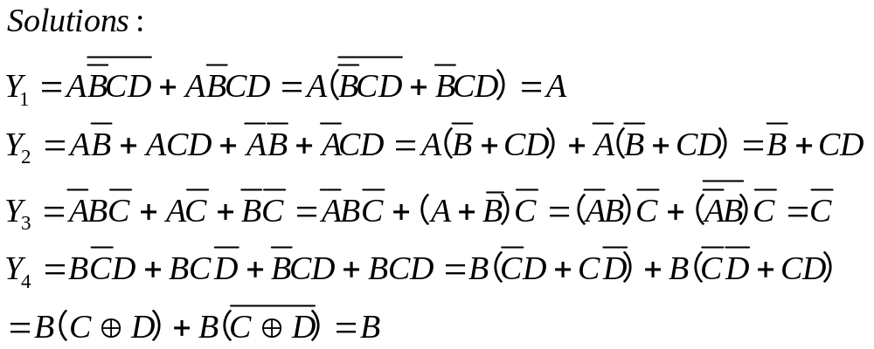

Slide 12
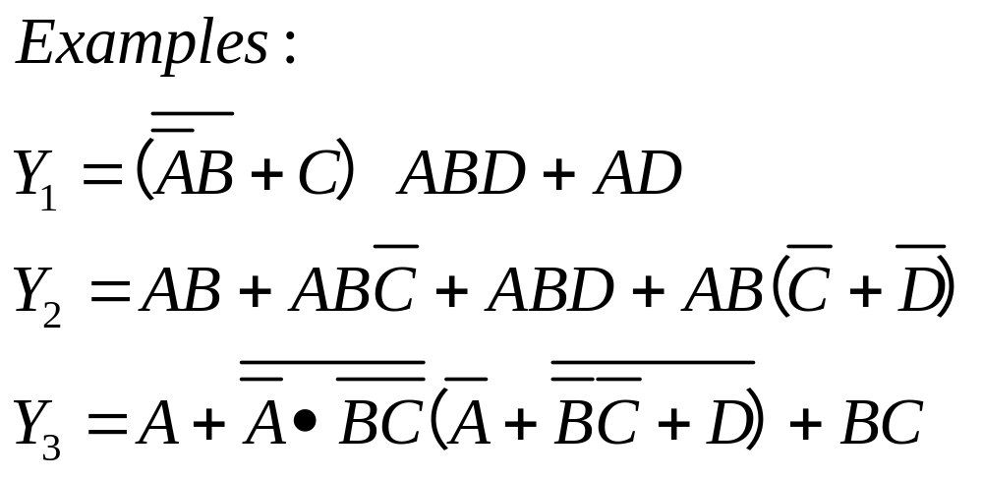
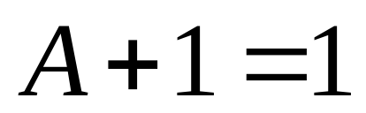

Slide 13
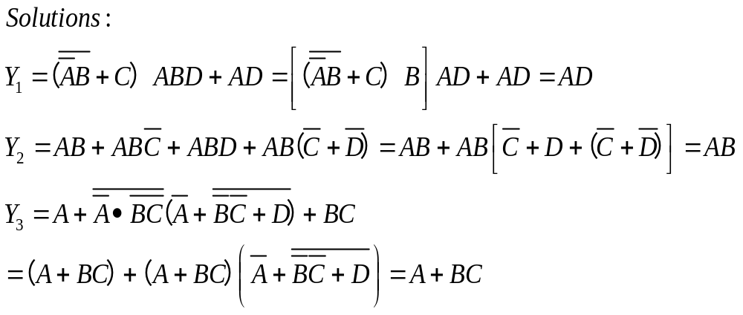

Slide 14
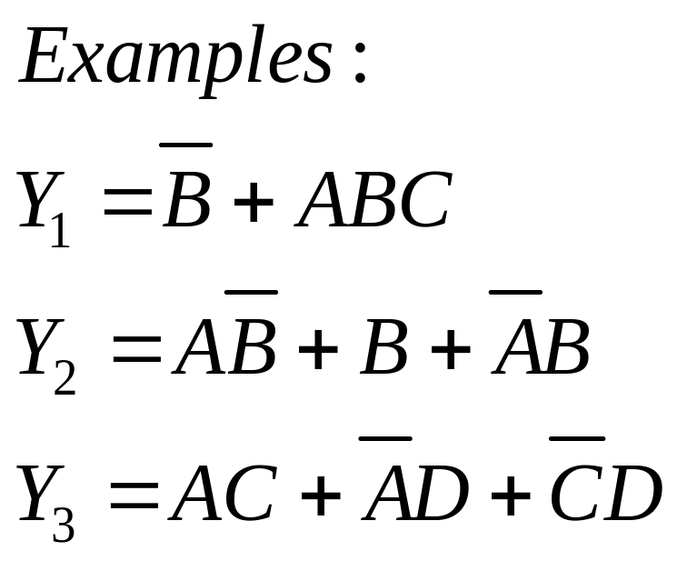


Slide 15
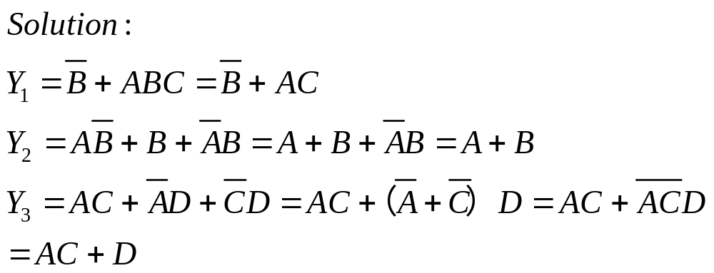

Slide 16
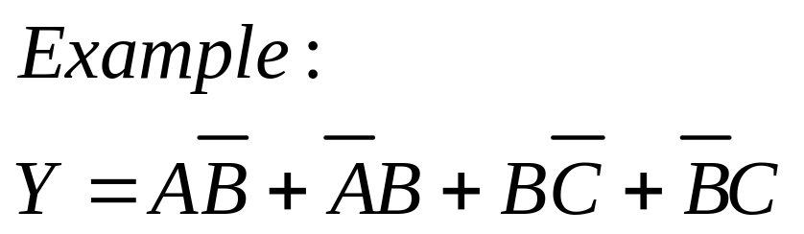


Slide 17
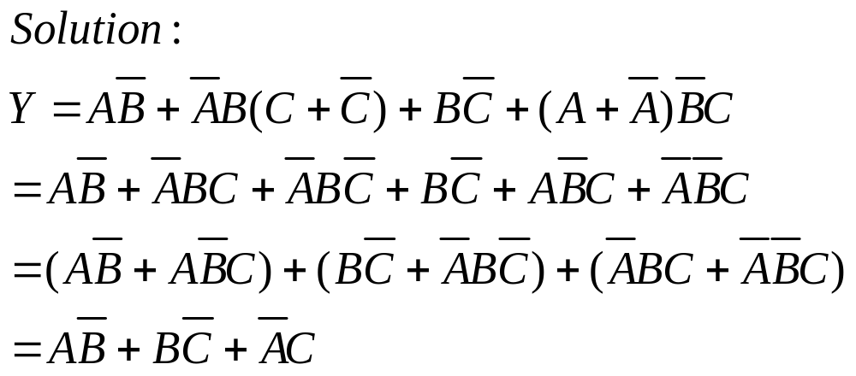

Slide 18
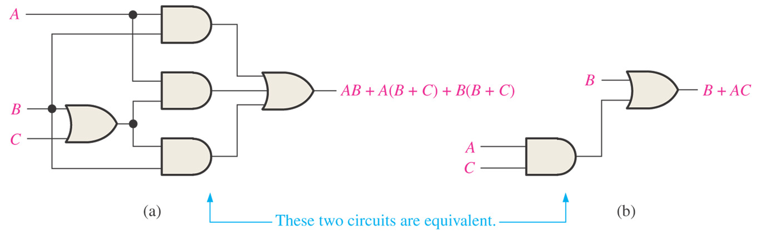
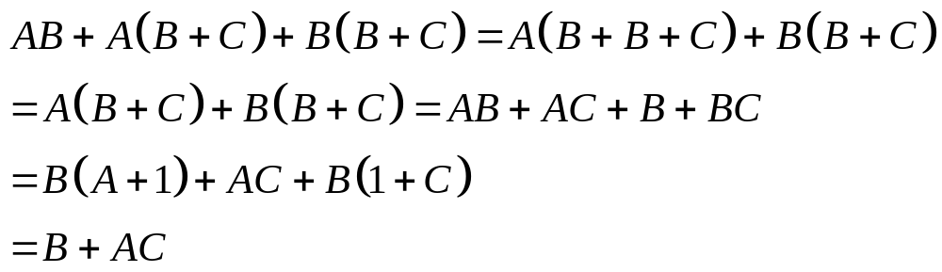

Slide 19
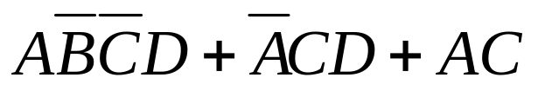
4.6 Standard Forms of Boolean Expressions
The sum-of-products (SOP) form
  A single overbar cannot extend over more than one variable;
  More than one variable in a term can have an overbar
The product-of-sums (POS) form
  A single overbar cannot extend over more than one variable
  More than one variable in a term can have an overbar
Example:
(A + B)(B + C + D)(A + C).

Slide 20
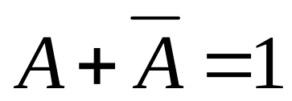
Conversion of a General Expression to SOP Form
  Applying the distributive law
The standard SOP Form
  All the variables in the domain appear in each product term in the expression
Converting Product Terms to Standard SOP
  Using

Slide 21
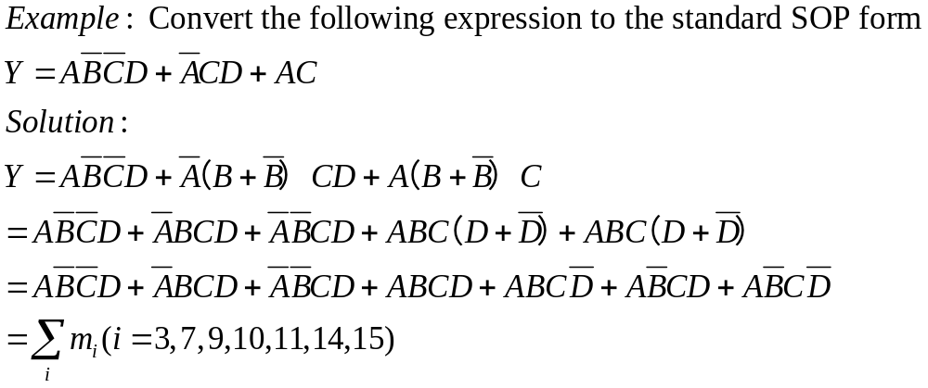

Slide 22
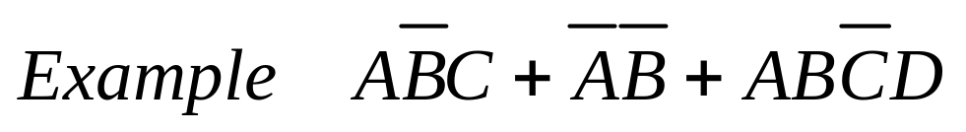
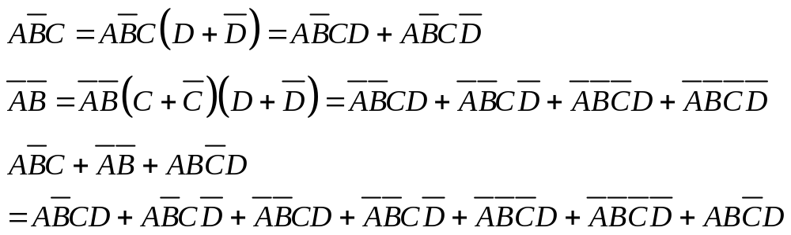

Slide 23
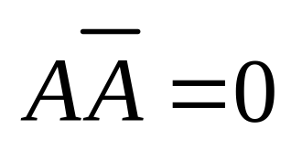
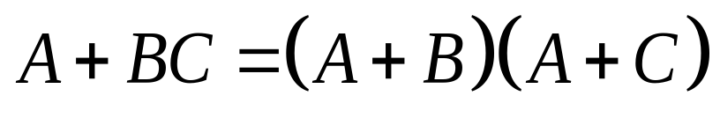
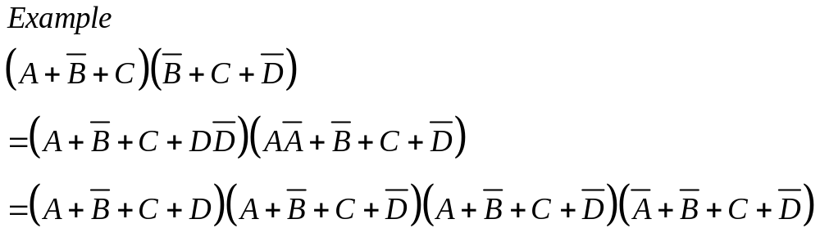
The Standard POS Form
  All the variables in the domain appear in each sum term in the expression.
  Converting a Sum Term to Standard POS
  Using

Slide 24
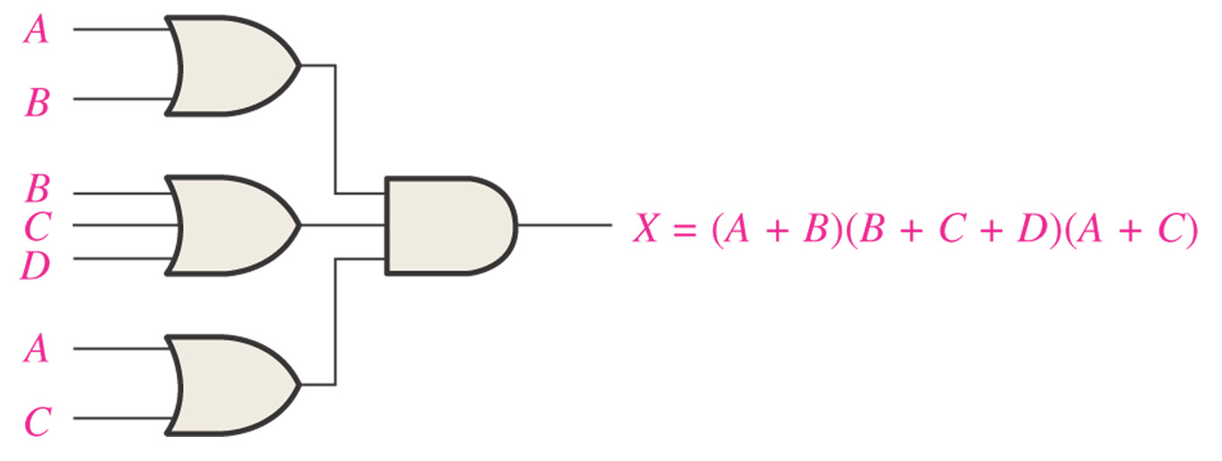

Slide 25
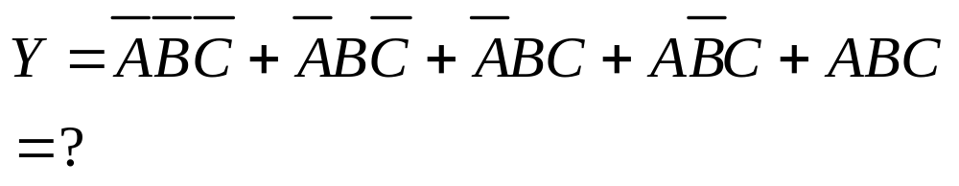
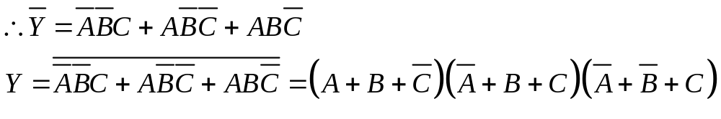
Converting standard SOP to standard POS
(standard SOP form)
(standard POS form)

Slide 26
4.7 Boolean Expressions and Truth Tables

Slide 27
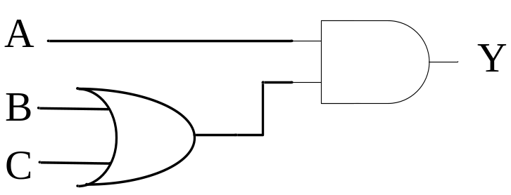
Truth Table
Input |  |  | Output Y
A | B | C
0 | 0 | 0 | 0
0 | 0 | 1 | 0
0 | 1 | 0 | 0
0 | 1 | 1 | 0
1 | 0 | 0 | 0
1 | 0 | 1 | 1
1 | 1 | 0 | 1
1 | 1 | 1 | 1
Boolean Expression
Y=A(B+C)
Implementation

Slide 28
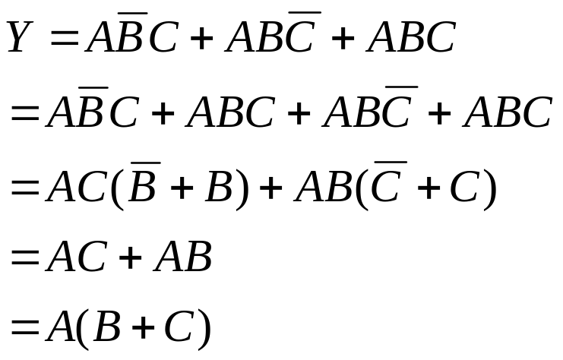



Converting Truth Table to Boolean Expression
Input |  |  | Output Y
A | B | C
0 | 0 | 0 | 0
0 | 0 | 1 | 0
0 | 1 | 0 | 0
0 | 1 | 1 | 0
1 | 0 | 0 | 0
1 | 0 | 1 | 1
1 | 1 | 0 | 1
1 | 1 | 1 | 1

Slide 29

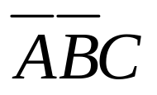
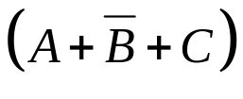
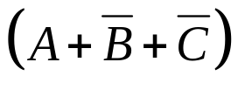
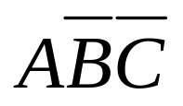
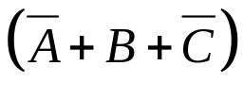
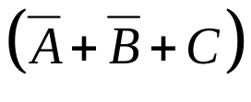

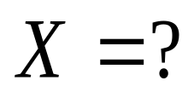
SOP expression, POS expression and truth table
Inputs
Output
P-Term
S-Term
A
B
C
X
0
0
0
0
0
0
1
1
0
1
0
0
0
1
1
0
1
0
0
1
1
0
1
0
1
1
0
0
1
1
1
1

Slide 30
4.8 The Karnaugh Map

Slide 31
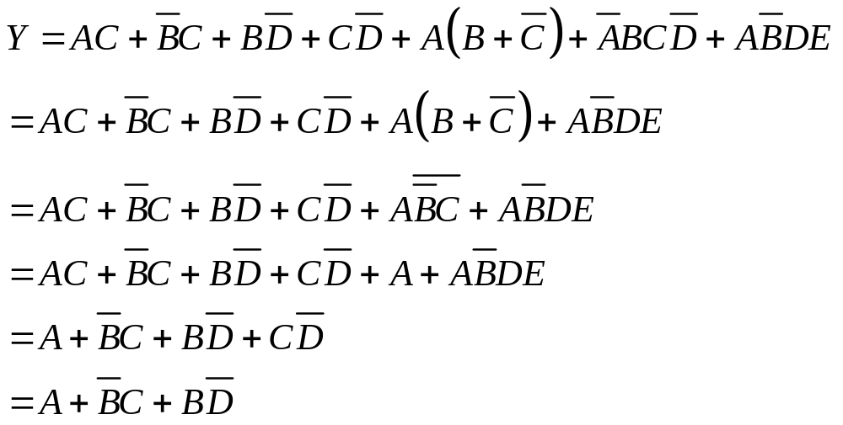





Example
Simplify the following Boolean expression

Slide 32
How do you think about this method?
Many Boolean rules are used
A little hard
…
Are there any other methods?

Slide 33
Karnaugh Map
A systematic method for simplifying Boolean expressions
Produce the simplest SOP or POS expression
Presents all of the possible values of input variables
  An array of cells
  Each cell represents a binary value of the input variables
  Adjacency in position equivalents to adjacency in Boolean algebra

Slide 34
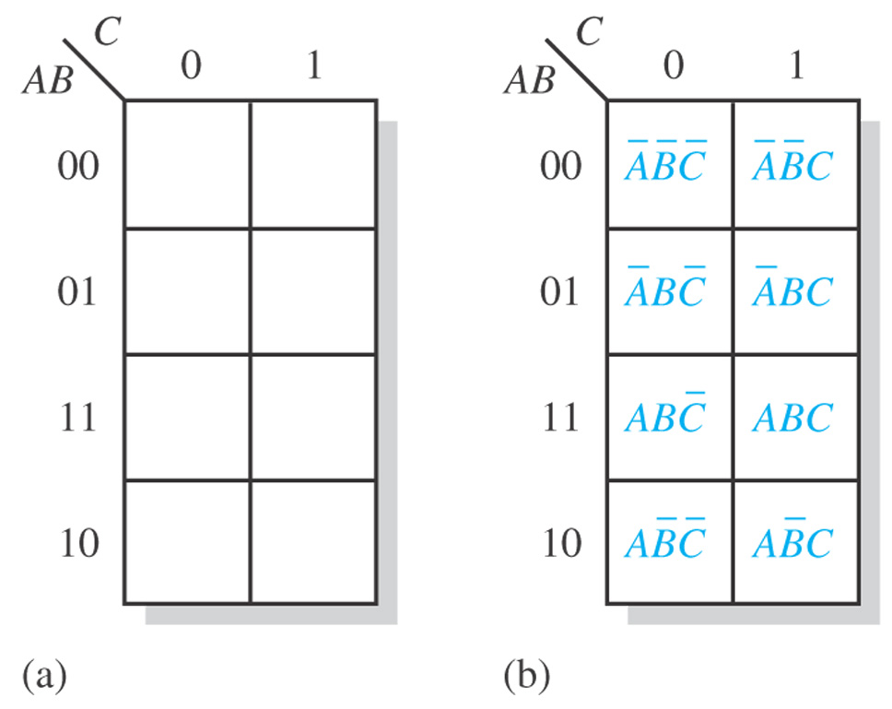
The Construction of Karnaugh Map

Slide 35
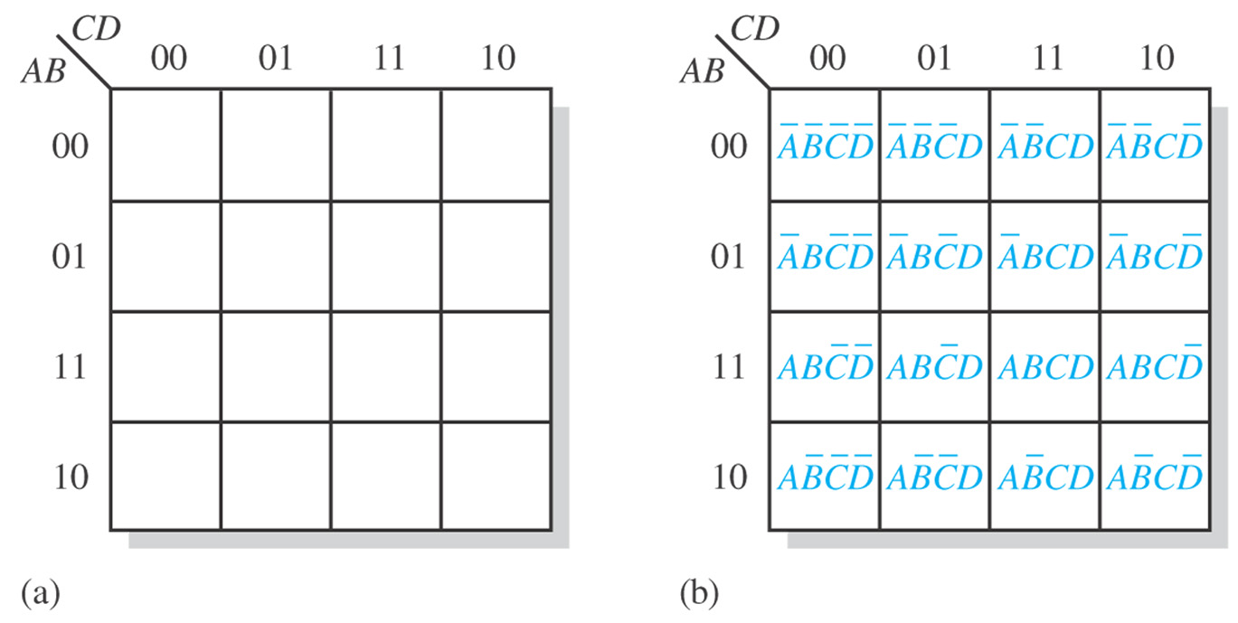
The Construction of Karnaugh Map

Slide 36
Cell Adjacency
Adjacency (in logic): a single-variable change
  Cells that differ by only one variable are adjacency
  Cells that differ by more than one variable are not adjacency
Adjacency (in location)
  Cells locate next to others

Slide 37
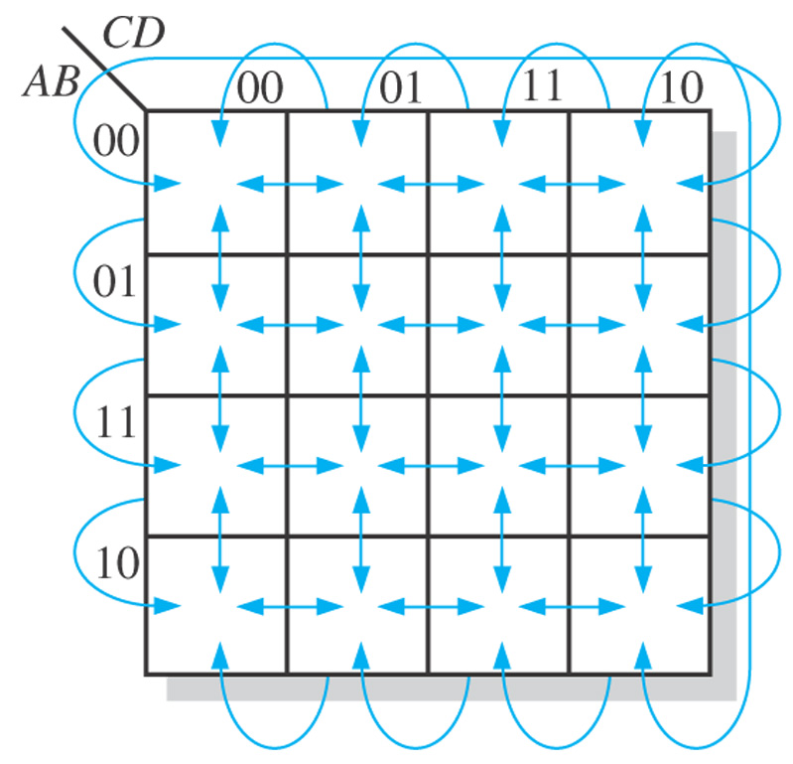
Cell Adjacency

Slide 38
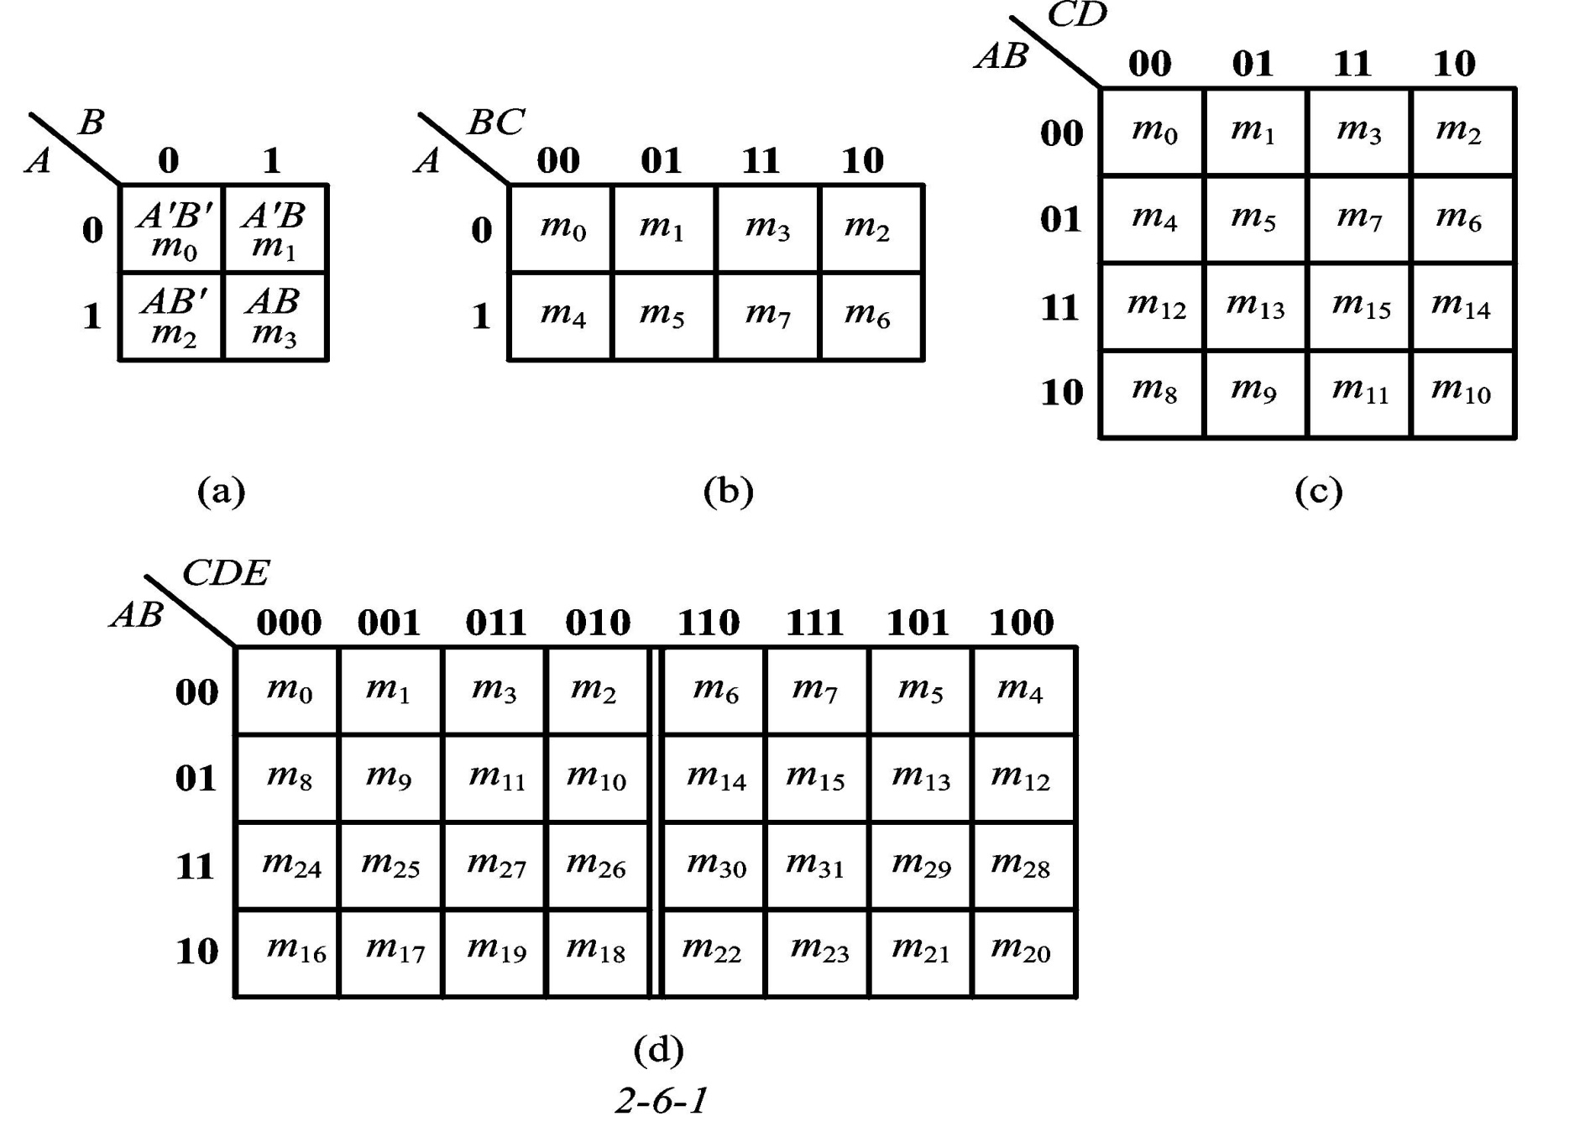

Slide 39
4.9 Karnaugh Map SOP Minization
Mapping a SOP Expression
Karnaugh Map Simplification of SOP Expressions

Slide 40
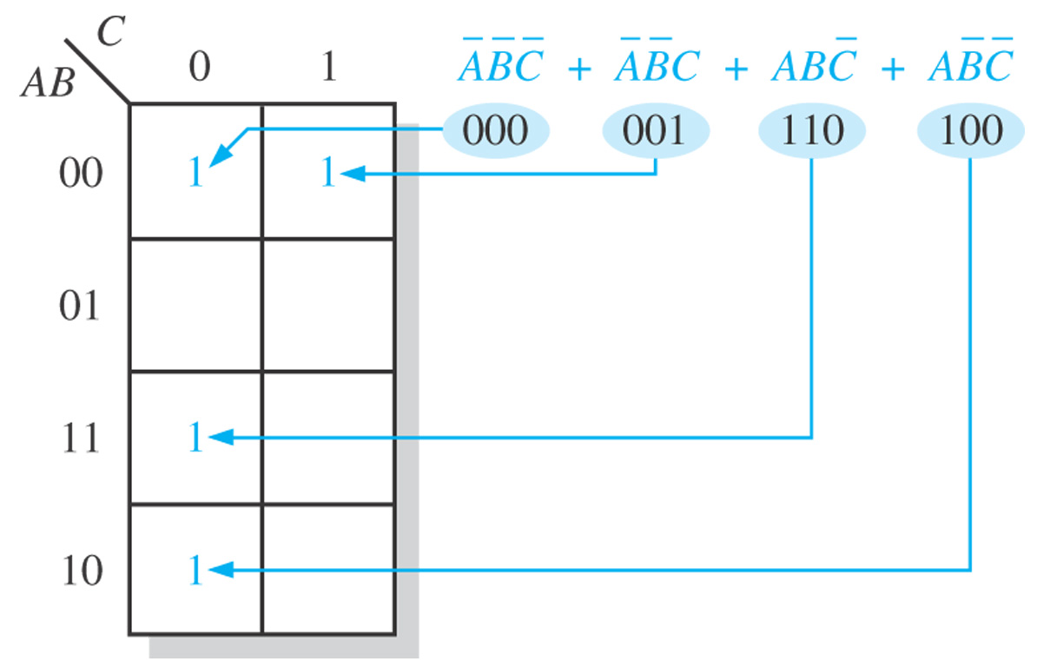
Example: Mapping a standard SOP expression

Slide 41


Slide 42
Karnaugh Map Simplification of SOP Expressions
Group the 1s
  Maximize the size of the groups
  Minimize the number of groups
Rules
  A group must contain 2^{n} cells
  Each cell must be adjacent to one or more cells in that group
  Include 1s as much as possible
  Each 1 on the map must be included at least one group
  Cell with 1 can be included into more than one group

Slide 43


Example: Group the 1s in each of the Karnaugh maps in the following figures.

Slide 44


Example: Determine the product terms for the Karnaugh map in the following figure and write the resulting minimum SOP expression.

Slide 45


Example: Determine the product terms for the Karnaugh map in the following figure and write the resulting minimum SOP expression.

Slide 46


Example: Determine the product terms for the Karnaugh map in the following figure and write the resulting minimum SOP expression.

Slide 47


Slide 48
Example
Simplify the following Boolean expression
10100
10101
10110
10111
11100
11101
11110
11111
00100
00101
00110
00111
10100
10101
10110
10111
01000
01001
01100
01101
11000
11001
11100
11101
00100
00101
01100
01101
10100
10101
11100
11101
11000
11001
11010
11011
11100
11101
11110
11111
10000
10001
10010
10011
11000
11001
11010
11011
01100
01101
10011
10111

Slide 49

CDE
 | 000 | 001 | 011 | 010 | 110 | 111 | 101 | 100
00 |  |  |  |  | 1 | 1 | 1 | 1
01 | 1 | 1 |  |  |  |  | 1 | 1
11 | 1 | 1 | 1 | 1 | 1 | 1 | 1 | 1
10 | 1 | 1 | 1 | 1 | 1 | 1 | 1 | 1
AB

Slide 50
Don’t care conditions
  Some input variable combinations are not allowed
    These unallowed states will never occur in application
    They can be treated as “don’t care” terms
  “don’t care” terms either a 1 or 0 may be assigned to the output

Slide 51


Slide 52
Summary
Boolean Algebra
  Variable
  Operation
  Laws and rules
Simplification of Boolean expression
SOP form and POS form
Karnaugh maps

Slide 53
HW
Page 157~159 (Edition 10)
  21
  33
  44
  49
  56

